Slide 1
Synaptic Plasticity “the only game in town” -R. Malenka
Short Term Plasticity
Paired pulse facilitation / depression
Presynaptic modulation
Presynaptic receptors
Postsynaptic modulation
Long Term Plasticity
LTP, LTD

Slide 2
Synapses vary! Some important questions…
Synapses are modified in response to a wide range of stimuli,
activity patterns, drugs, behavioral states, etc…
When changes in synaptic strength occur, what caused the change?
…change in neurotransmitter release?
Mechanism?
…change in postsynaptic sensitivity to neurotransmitter?
Mechanism?
…change in synapse number?
Mechanism?
“Necessary”, “Sufficient”, “Mediator”, “Modulator”….

Slide 3
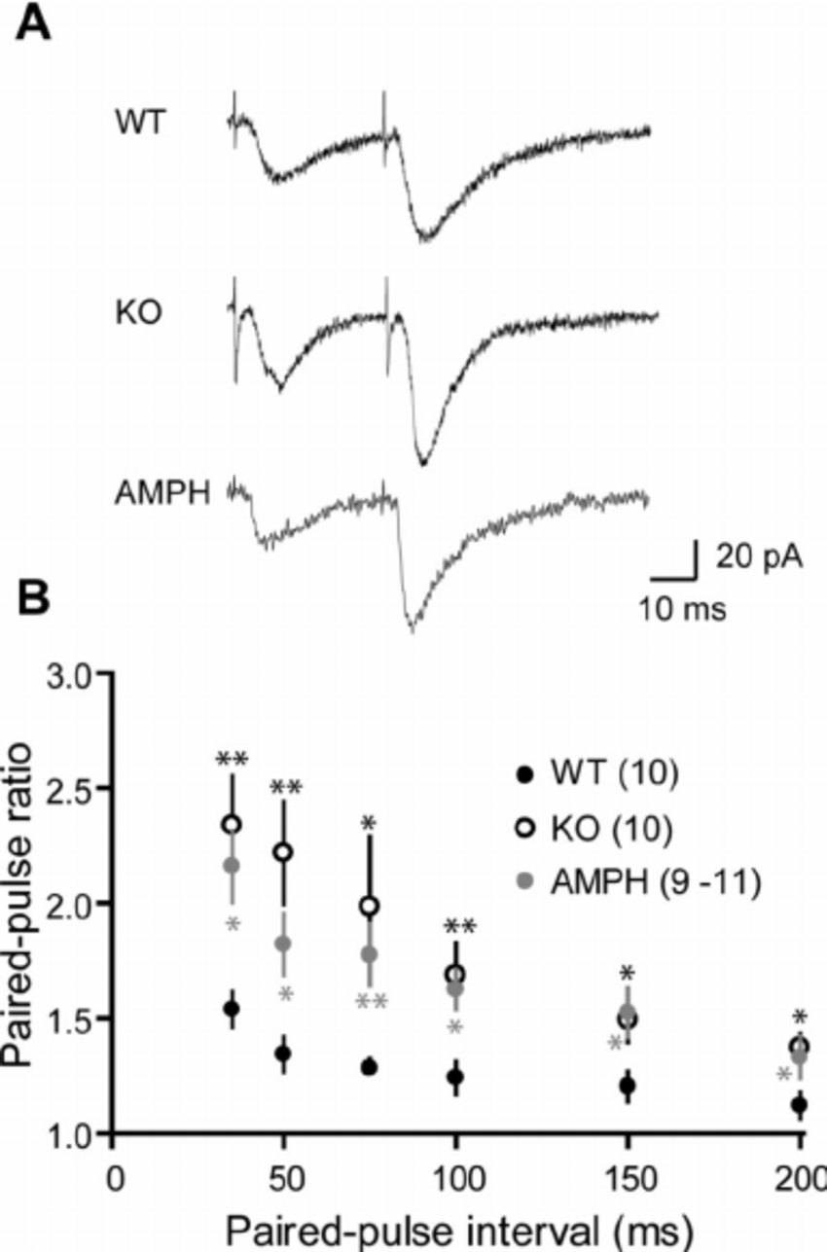
Paired Pulse Ratio
ISI = 50 msec
ISI = 200 msec
Paired-pulse Ratio P2/P1
Interval Between Pulses (msec)

Slide 4
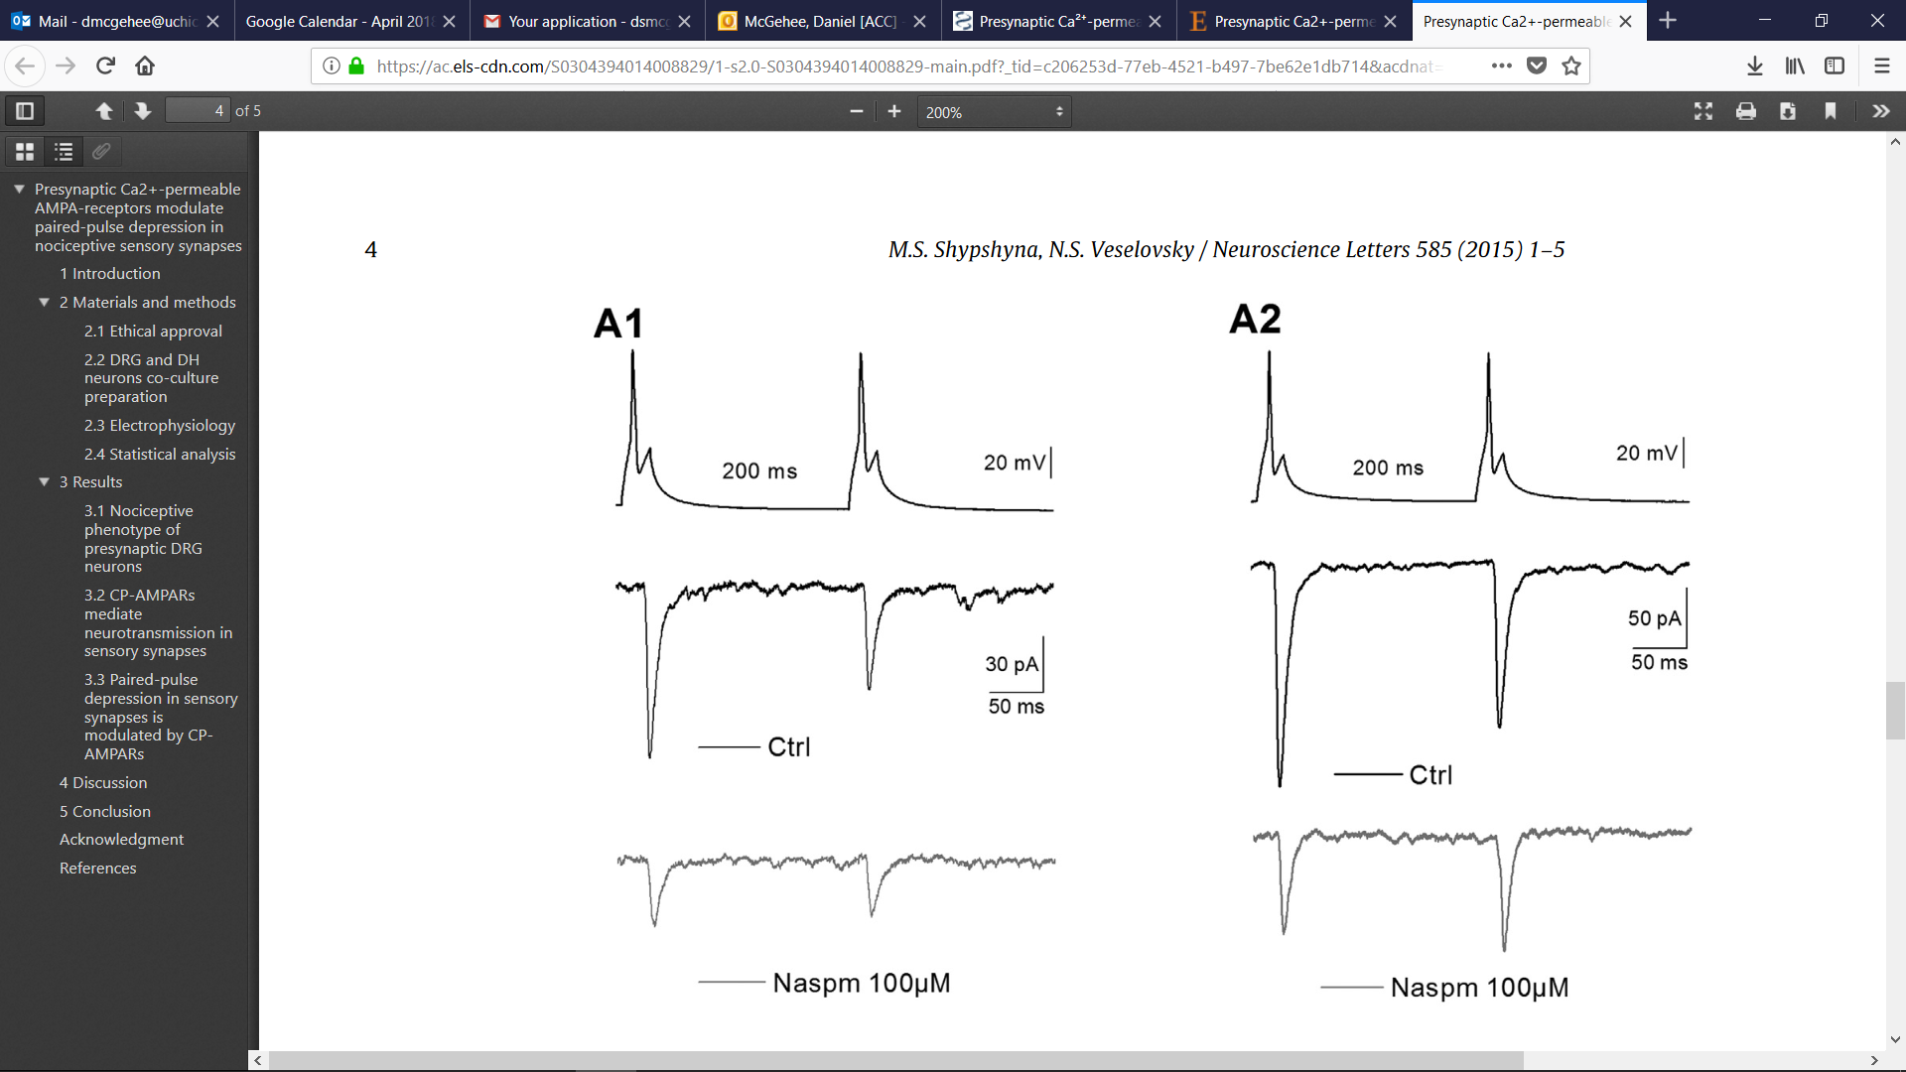
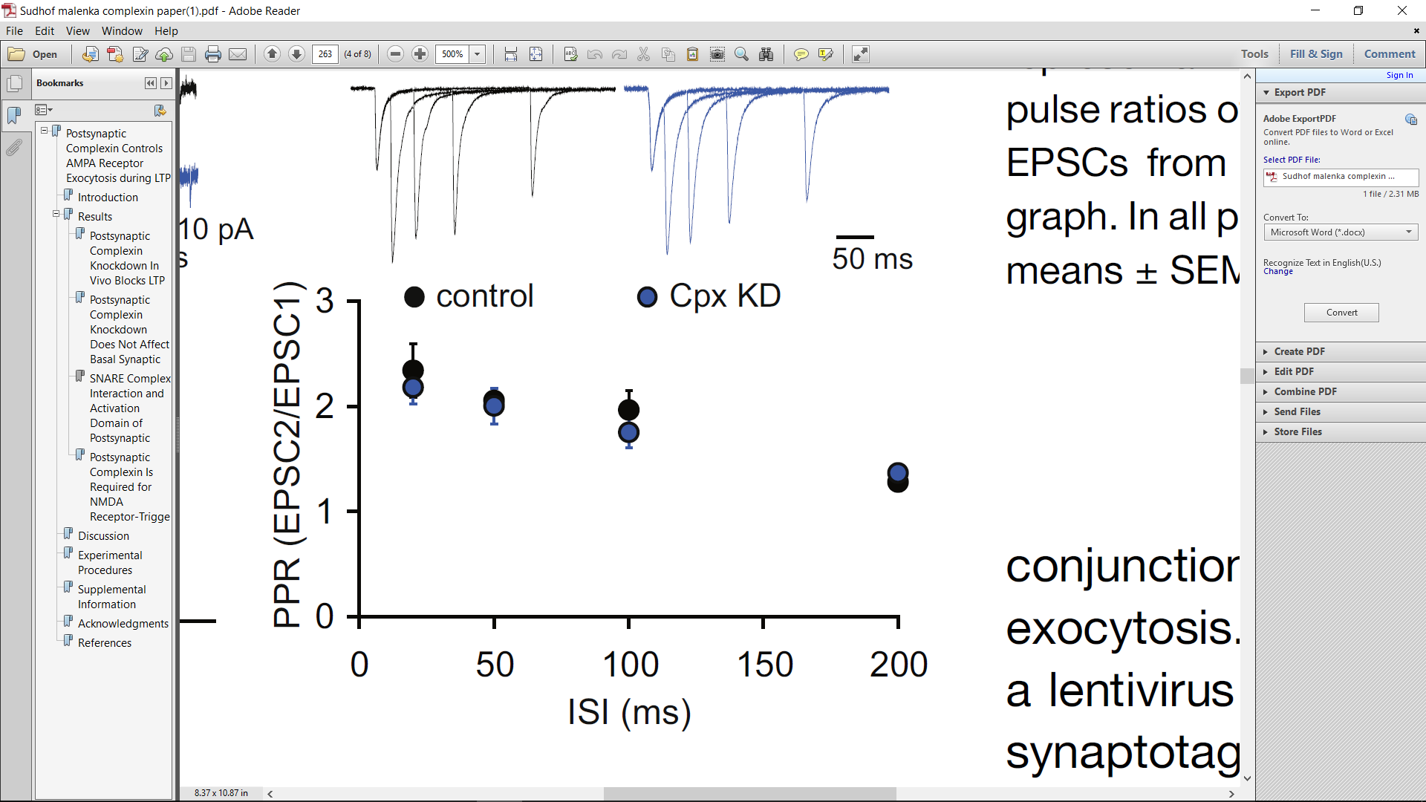
Paired Pulse Ratio
Facilitation
Depression
Pre
Post
Ahmad et al 2012
Shypshyna & Veselovsk 2015
Notes:
(Left) PAIRED PULSE FACILITATION: EPSCs from CA1 hippocampal neurons in a brain slice preparation. Paired pulse ratios of AMPAR EPSCs are unchanged in complexin knockdown cells. Two representative cells are shown above the graph. (Right) PAIRED PULSE DEPRESSION: Recording from a dorsal horn neuron in co-culture with peripheral sensory neurons

Slide 5
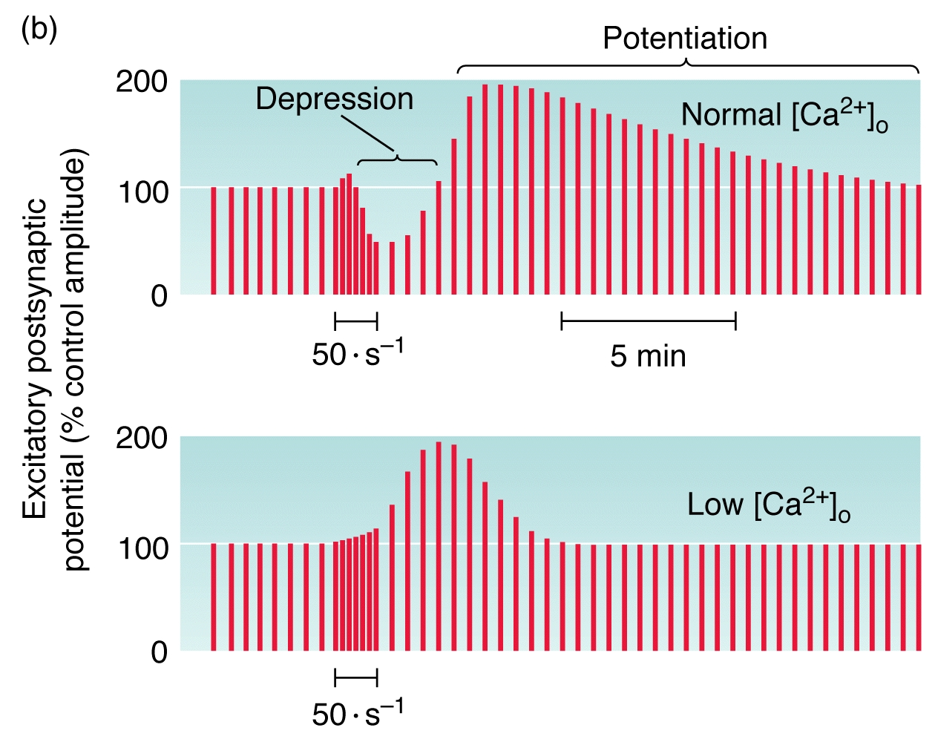
Post-Tetanic Potentiation at the NMJ

Slide 6
Modulation of Synaptic Strength via Presynaptic Receptors

Slide 7
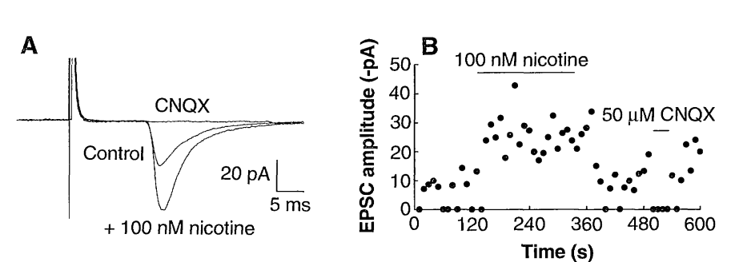
Nicotine Enhances Excitatory Synaptic Transmission
McGehee et al 1995

Slide 8
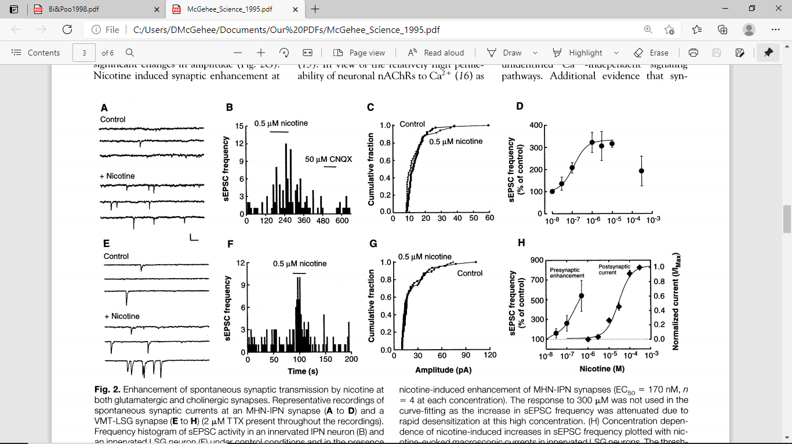
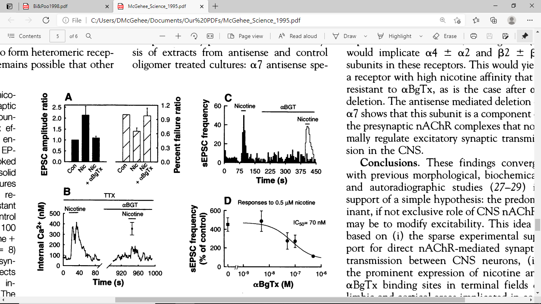
Nicotine Enhances Excitatory Synaptic Transmission via a7 nAChRs
McGehee et al 1995

Slide 9
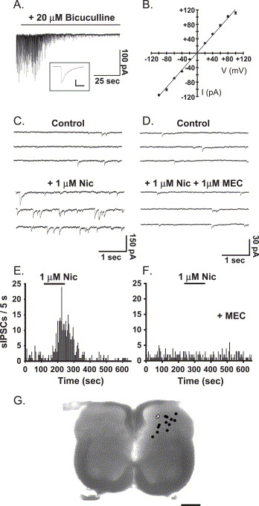
β2* nAChRs enhance inhibitory drive to spinal dorsal horn neurons
Genzen et al 2005

Slide 10
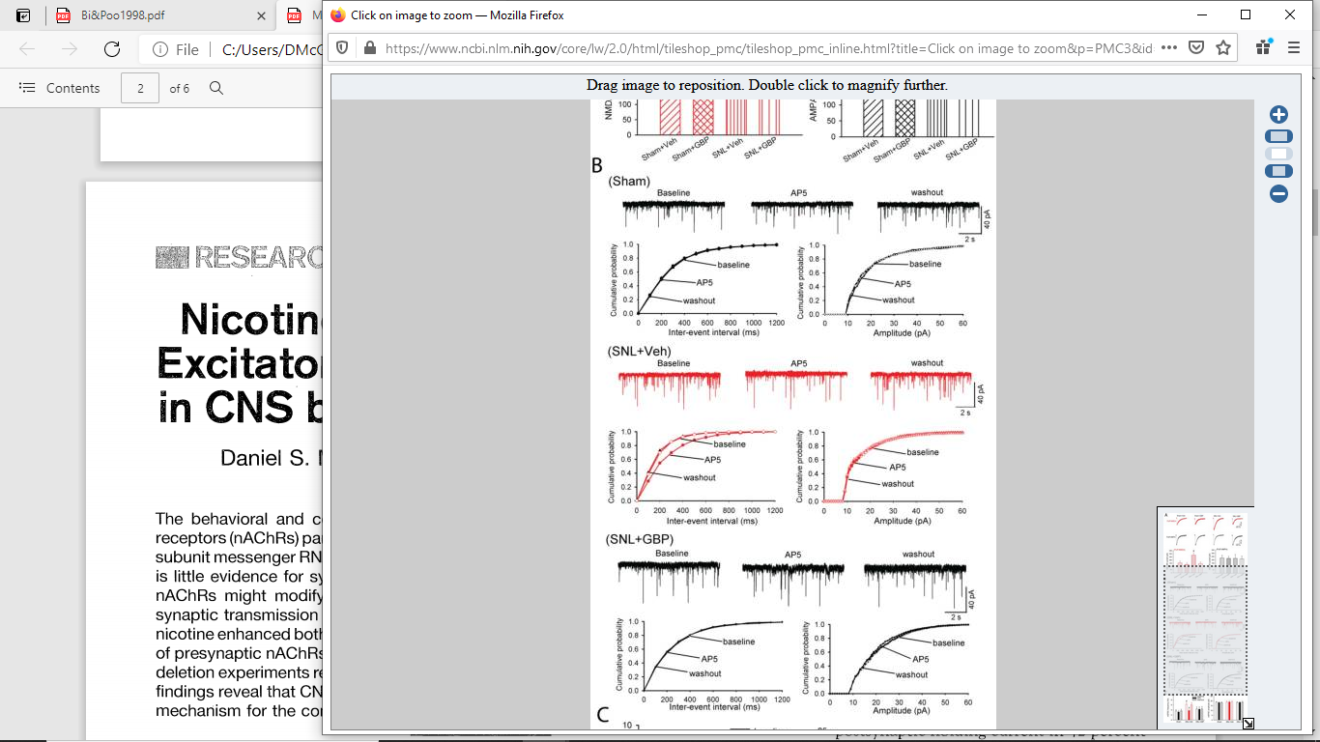
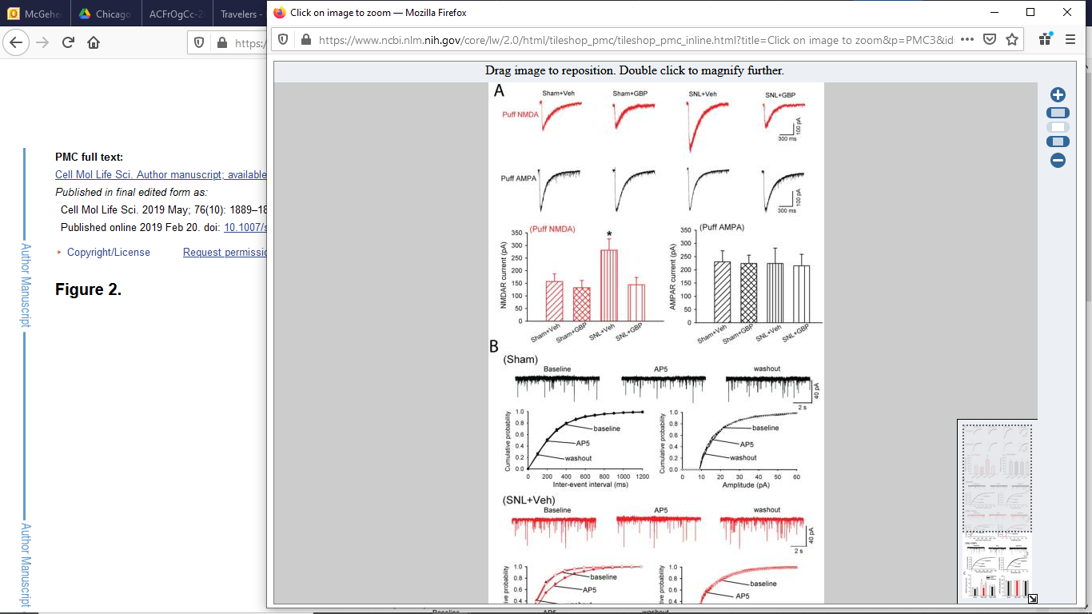
Presynaptic NMDA receptors in spinal cord are increased in a chronic pain state
Deng et al., 2019

Slide 11
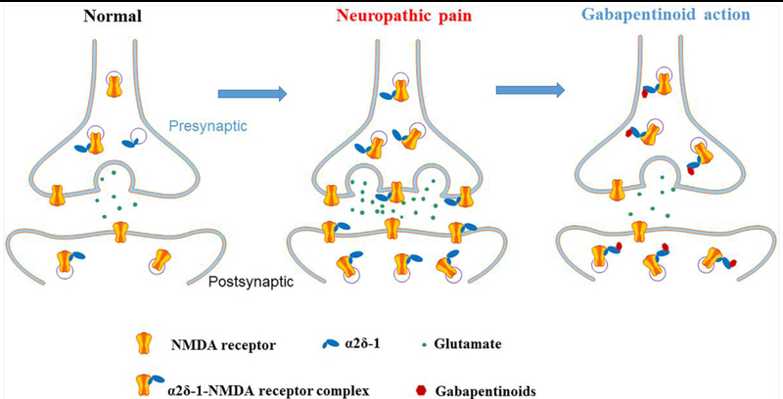
Presynaptic NMDA Receptors and Neuropathic Pain
Deng et al., 2019

Slide 12
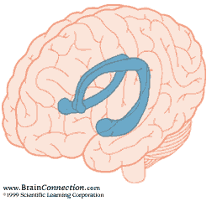
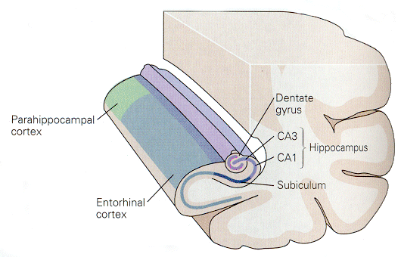
Hippocampus

Slide 13
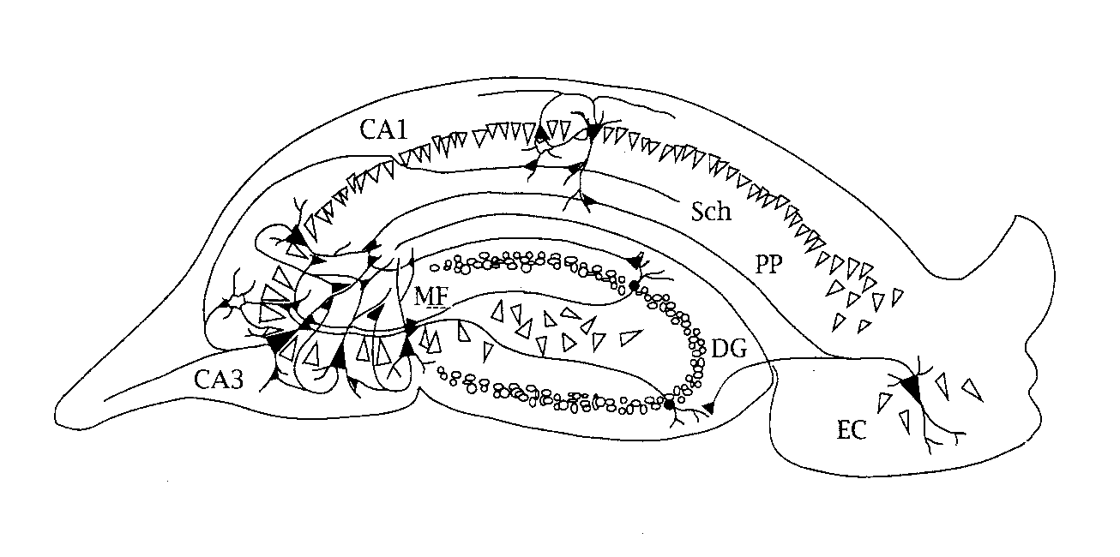
Hippocampus

Slide 14
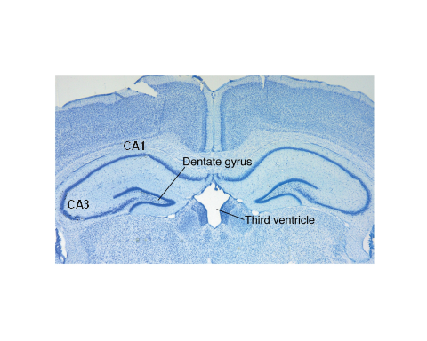
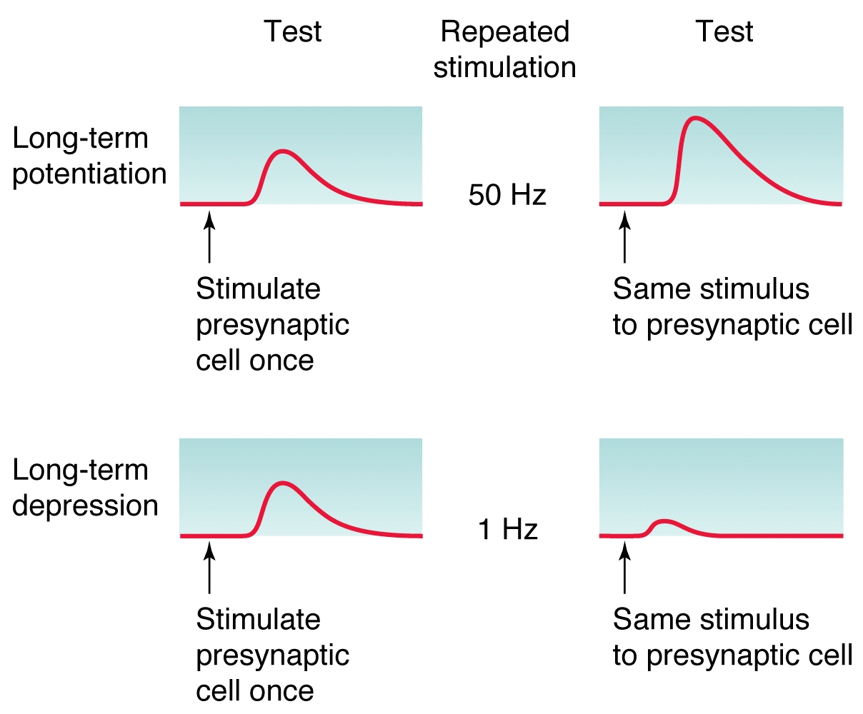

Slide 15
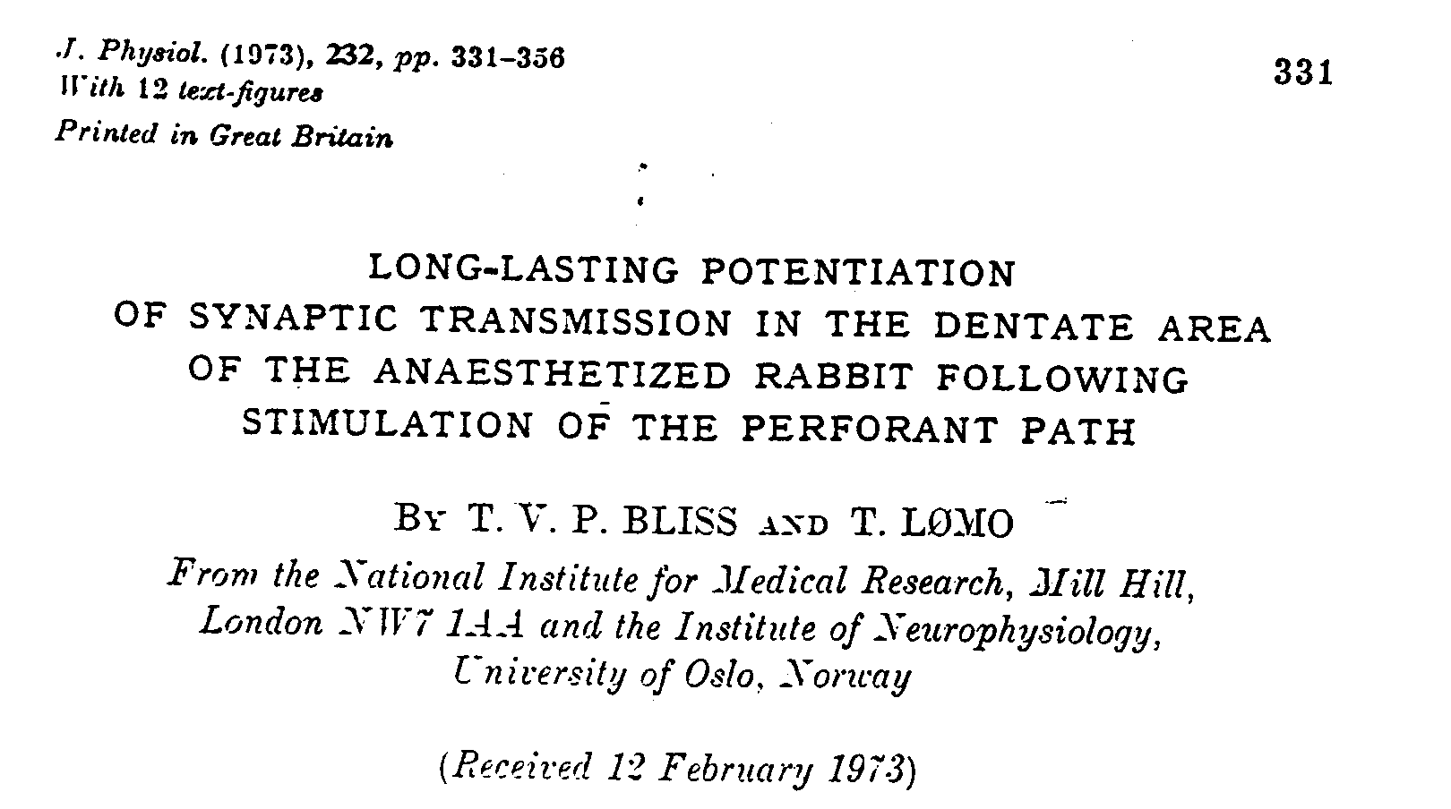
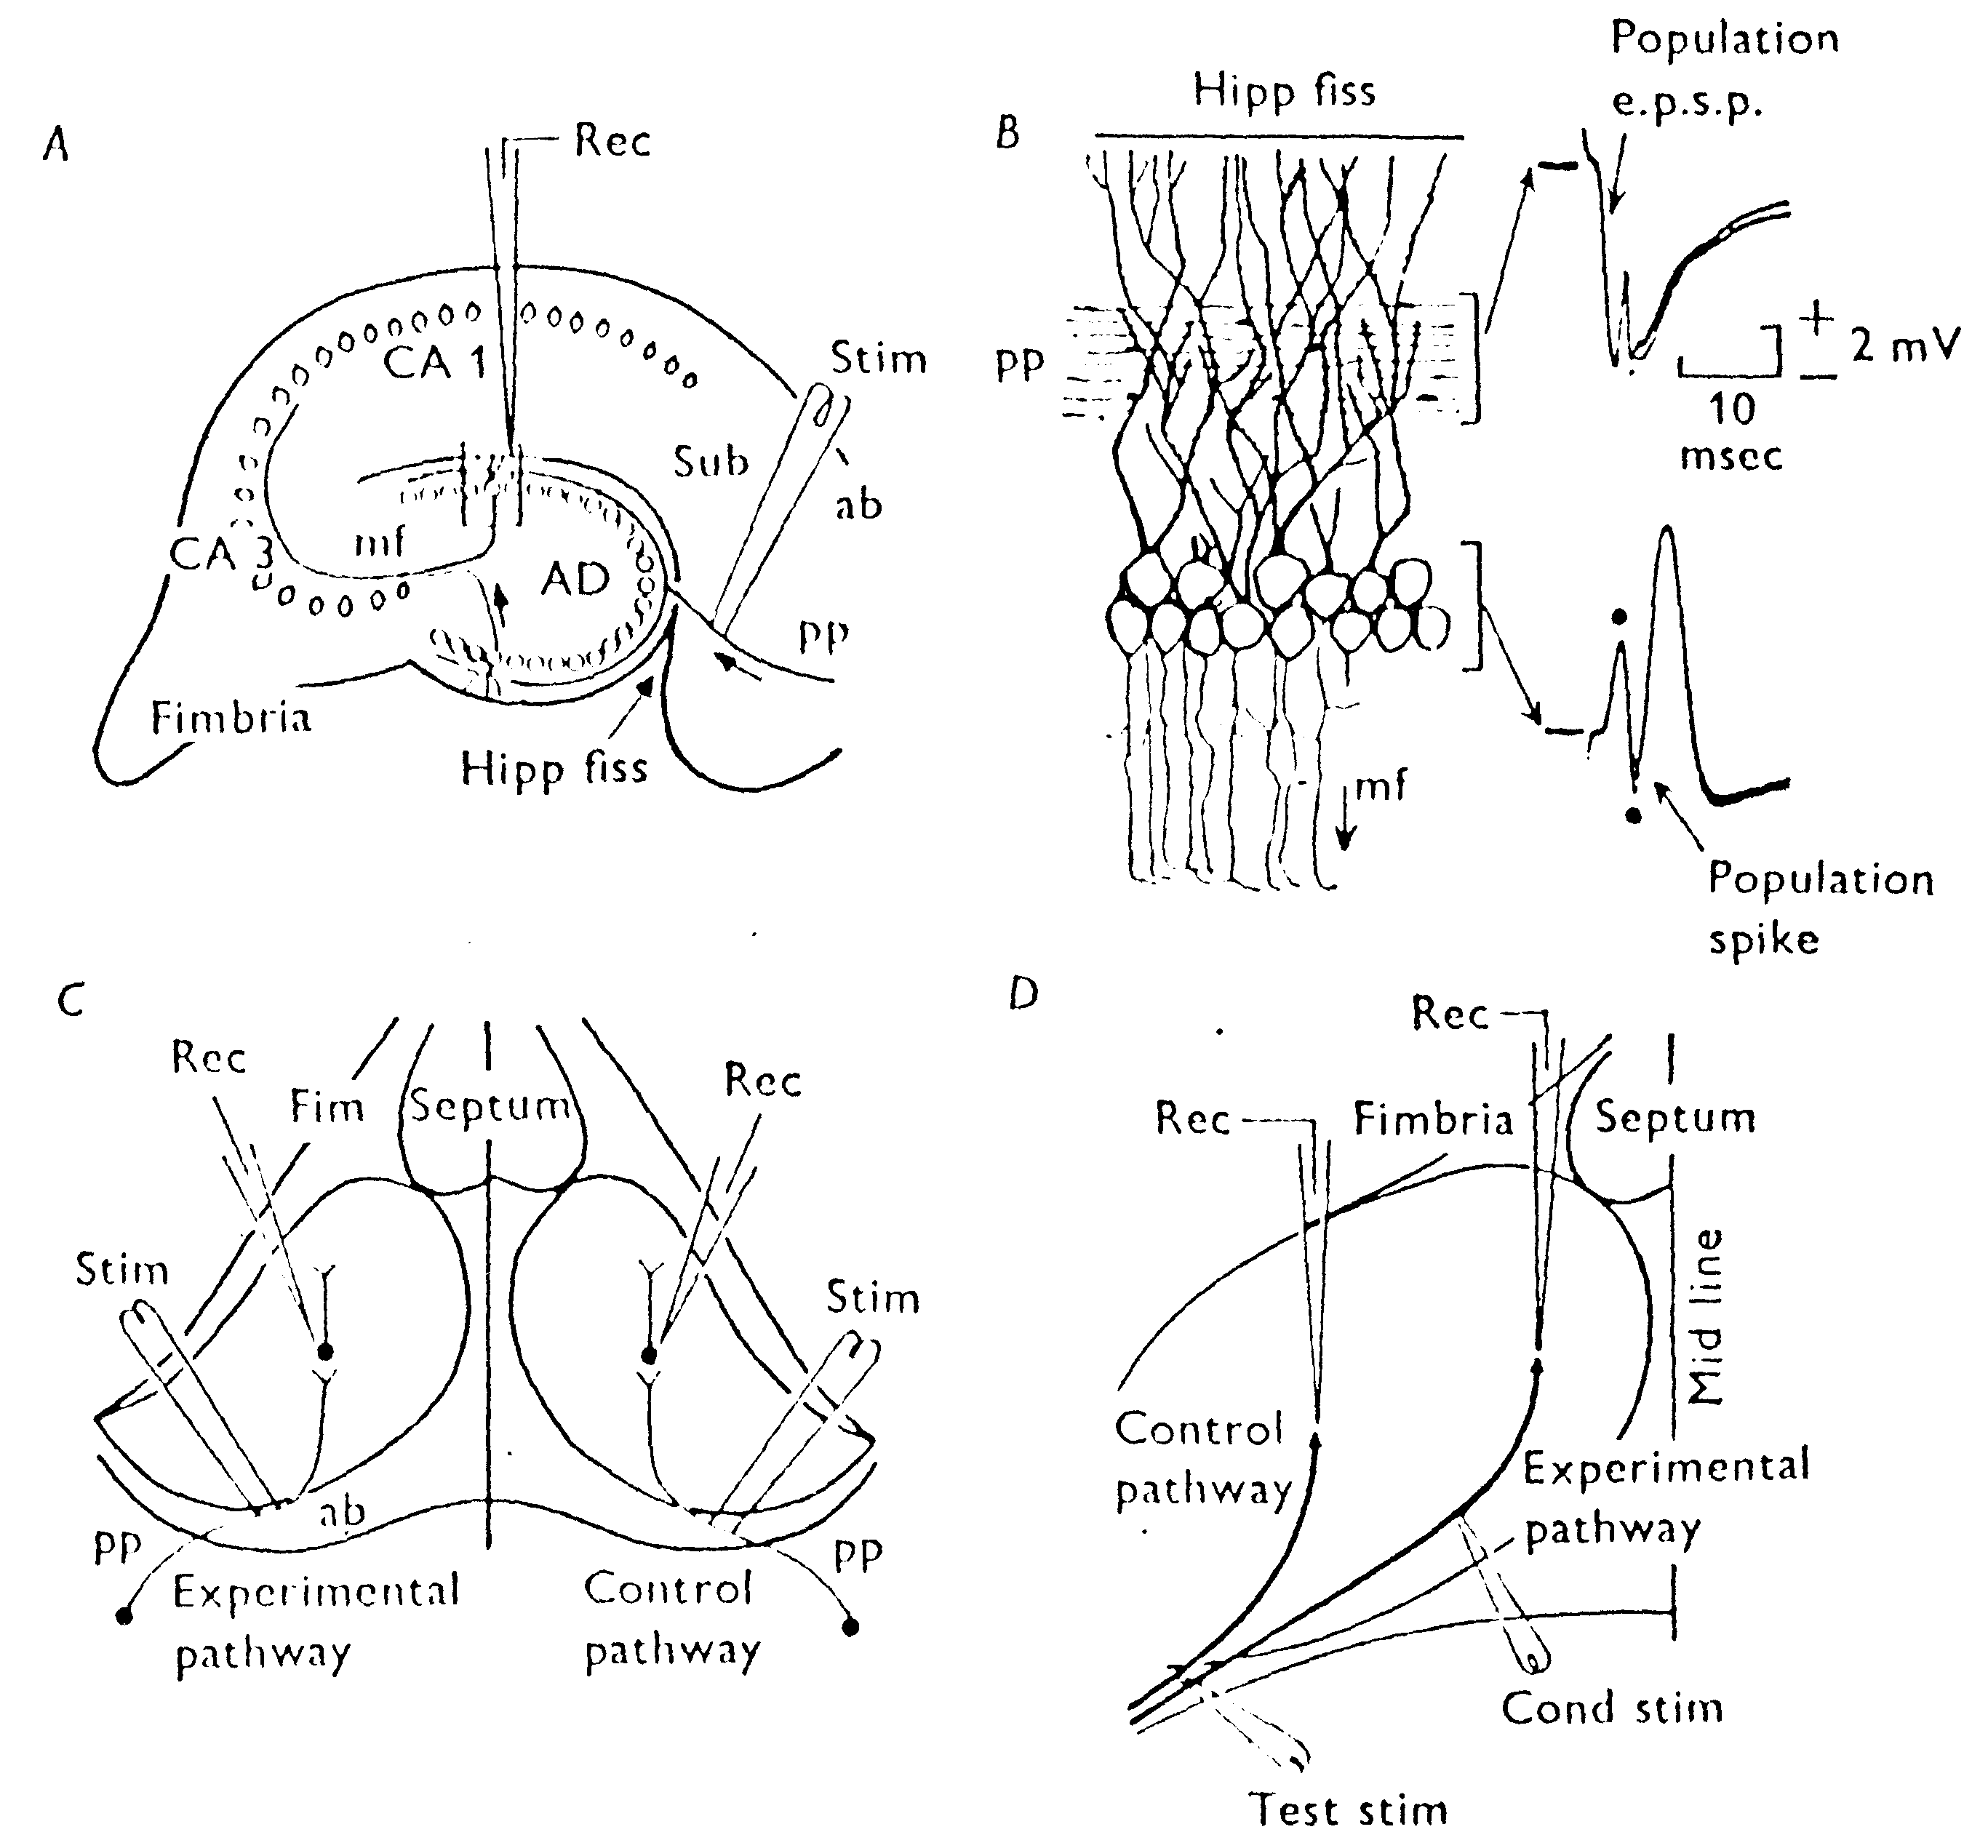

Slide 16
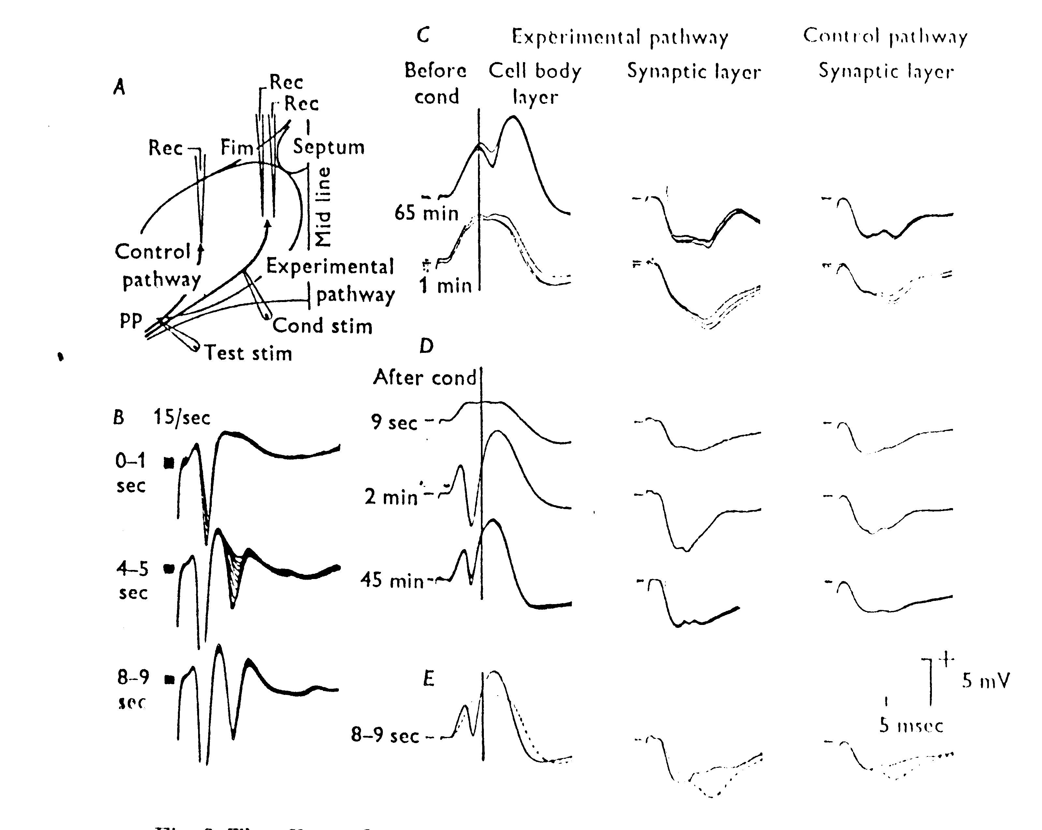
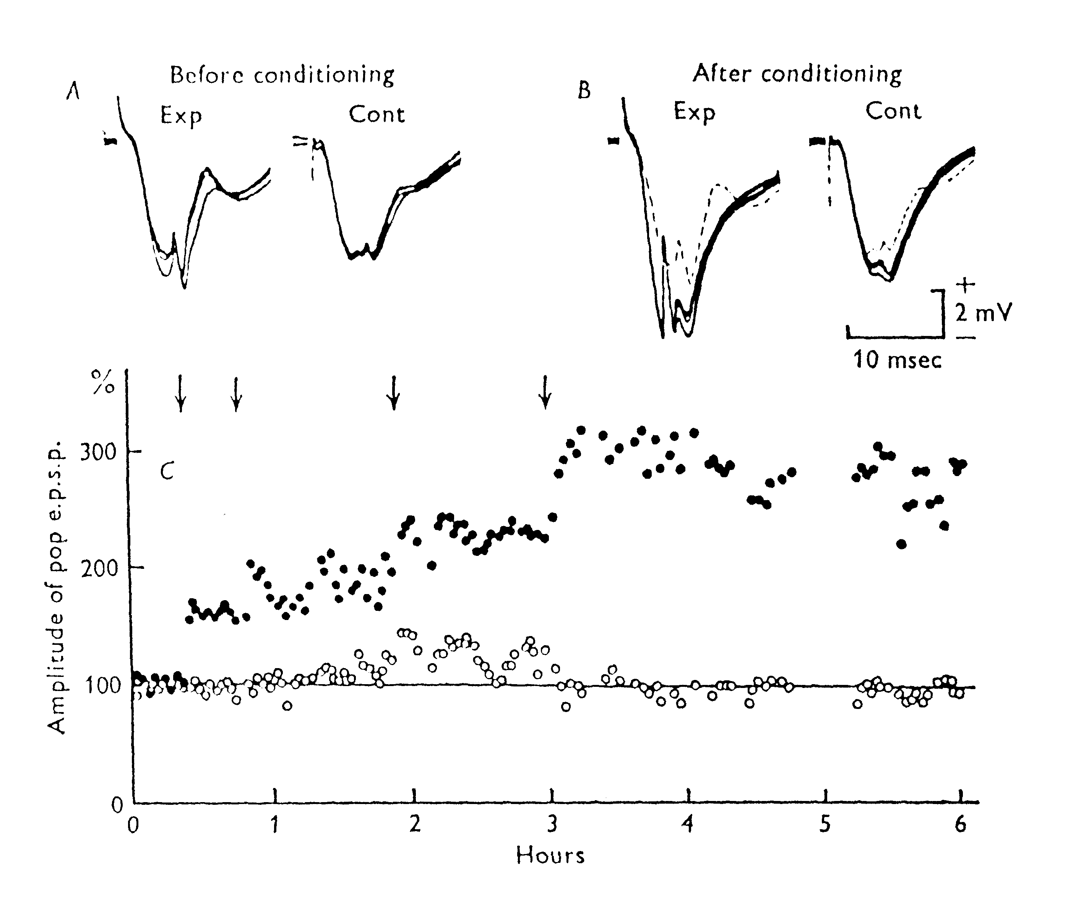

Slide 17
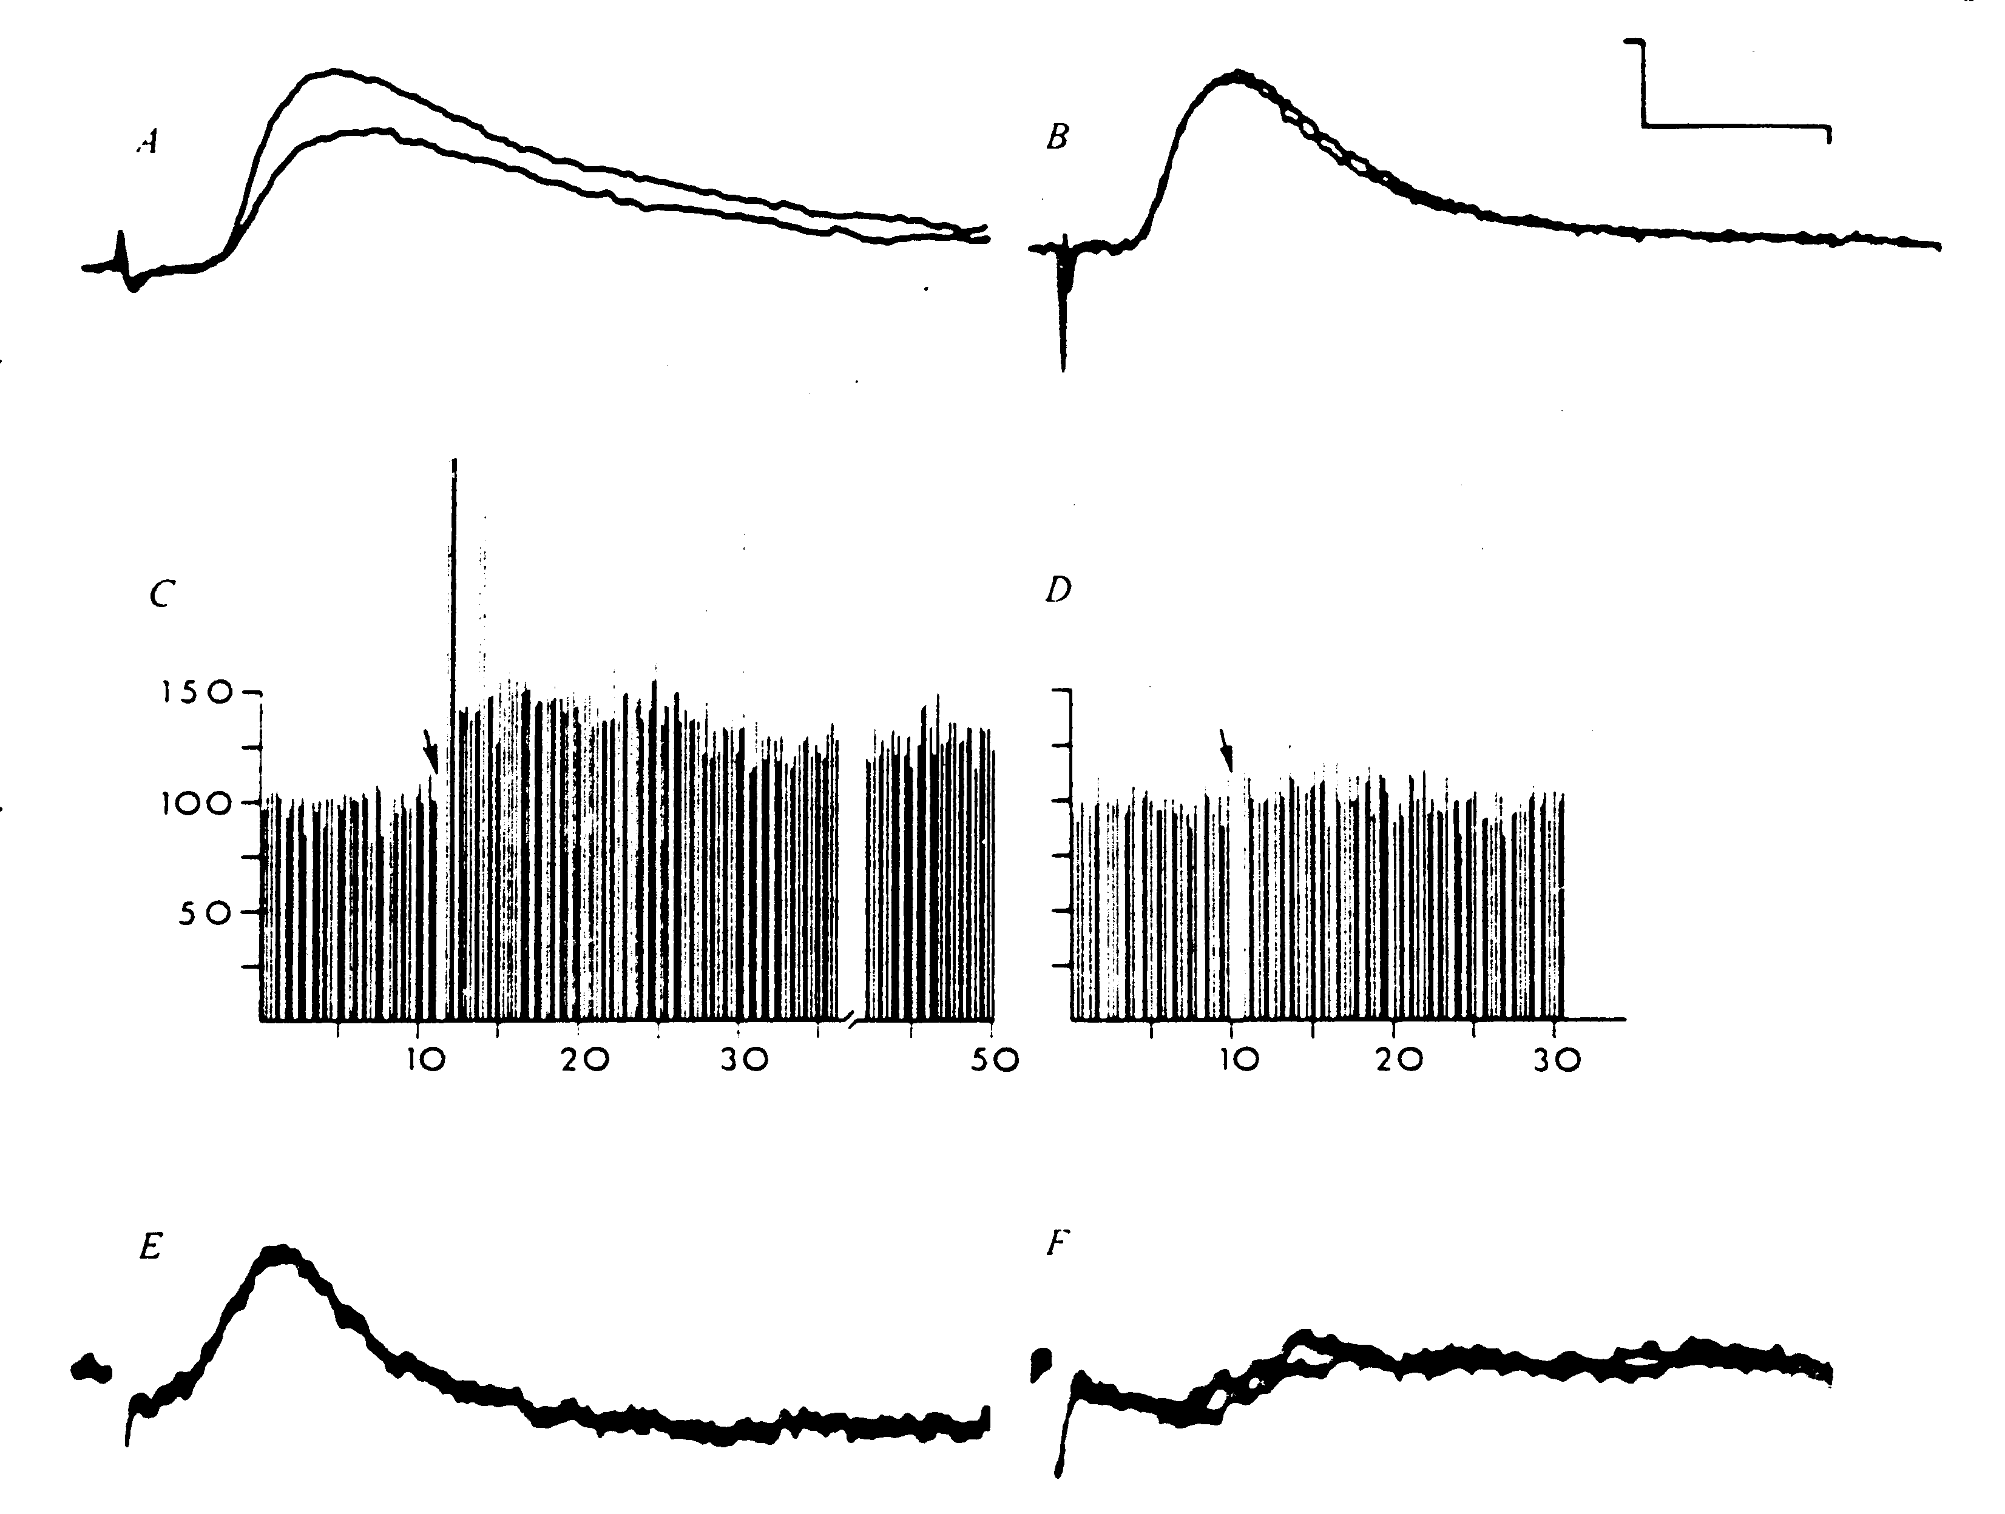
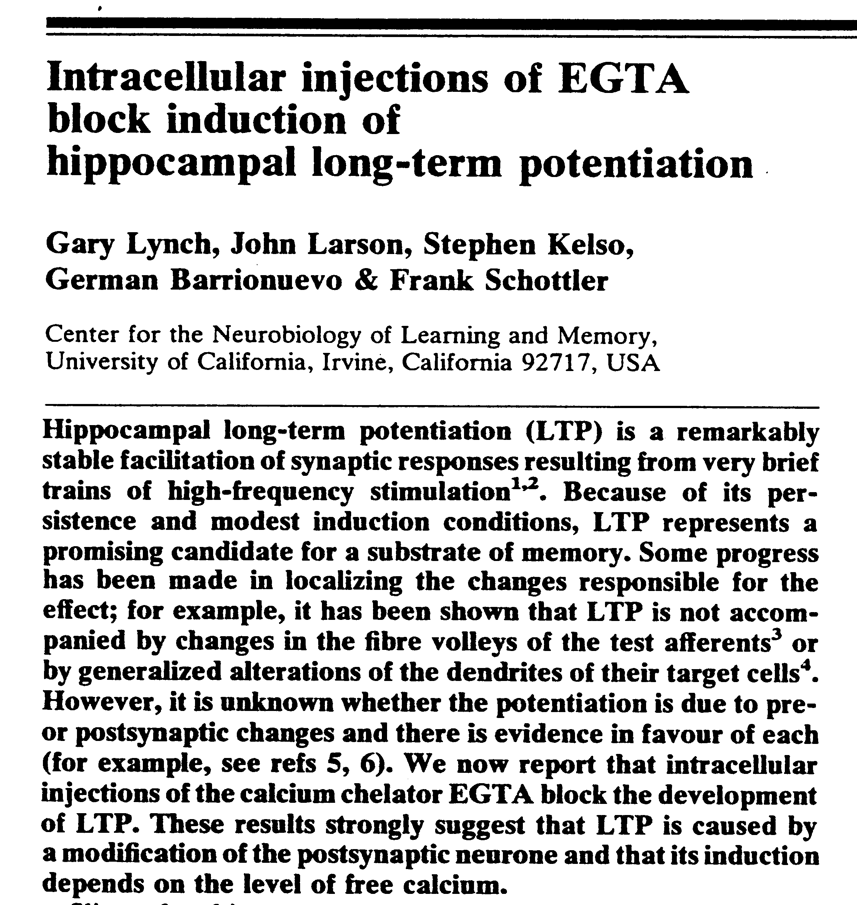
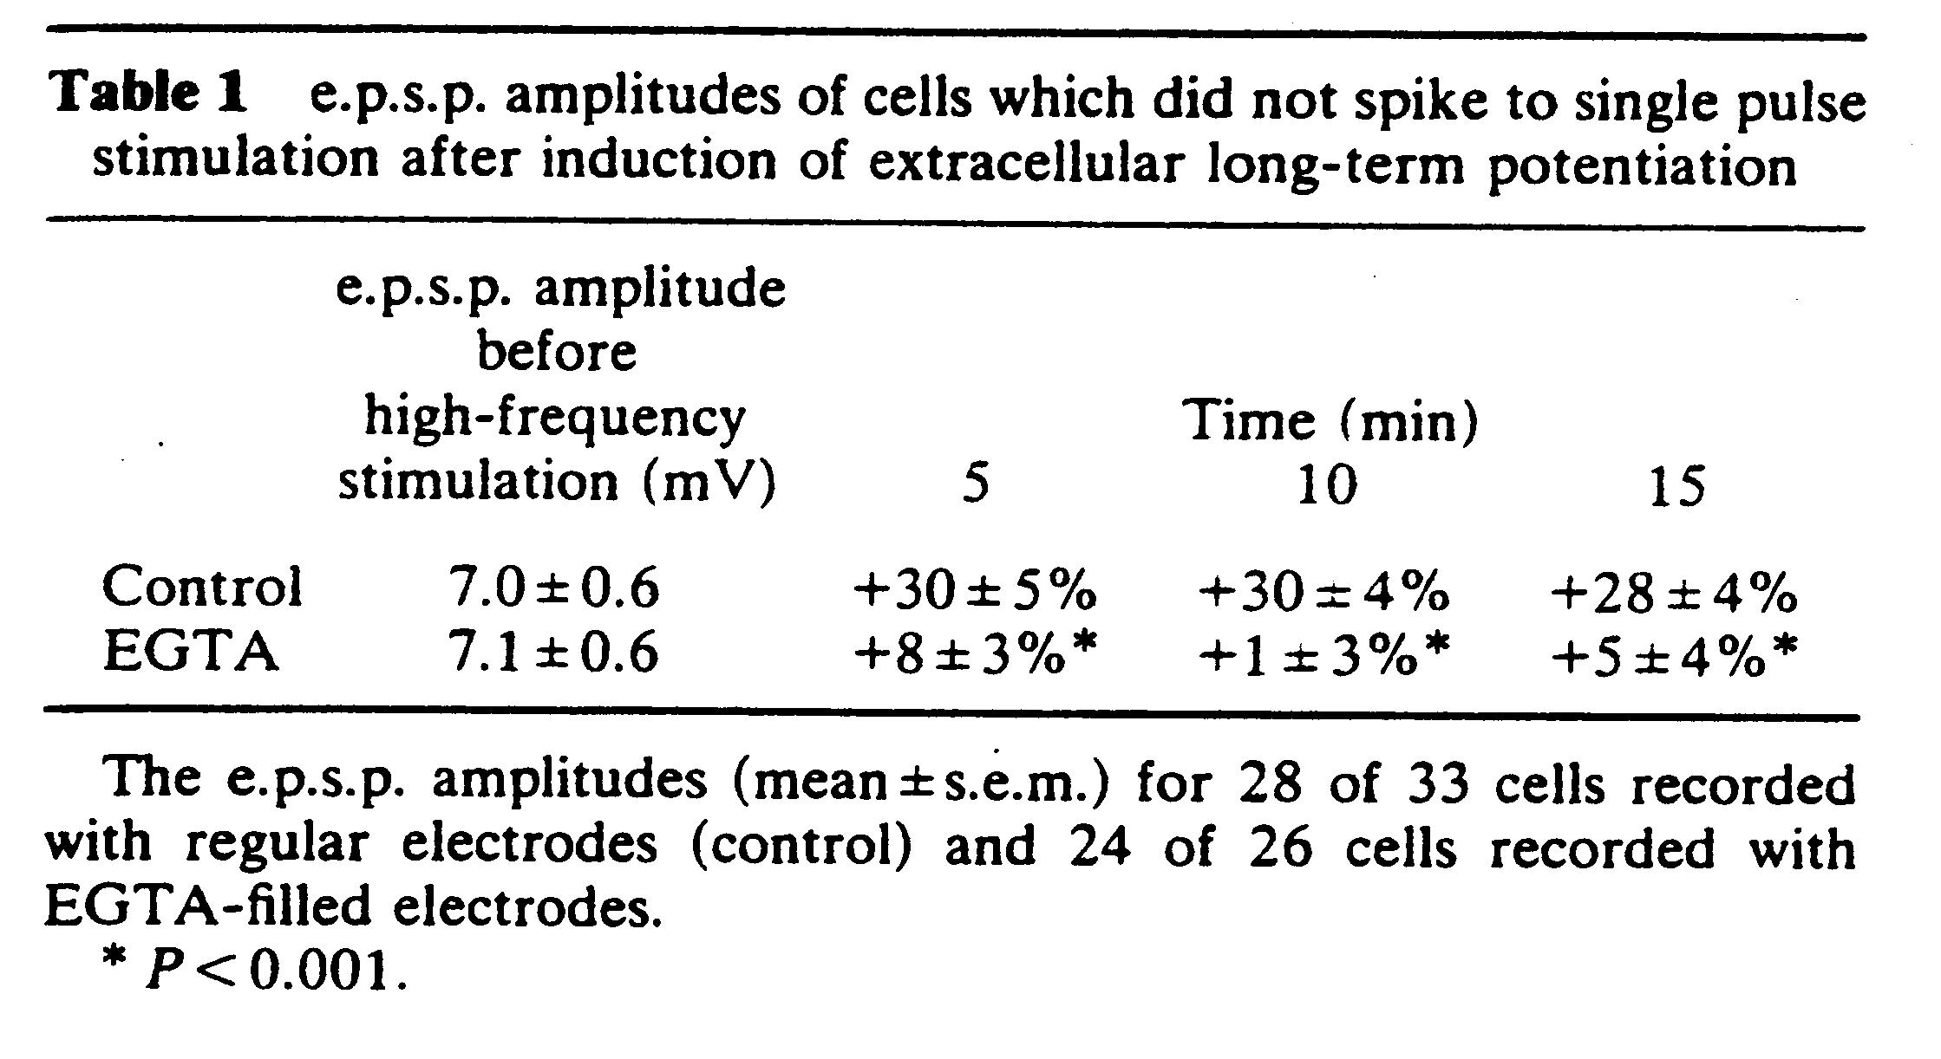
Nature 305:719-21 1983

Slide 18
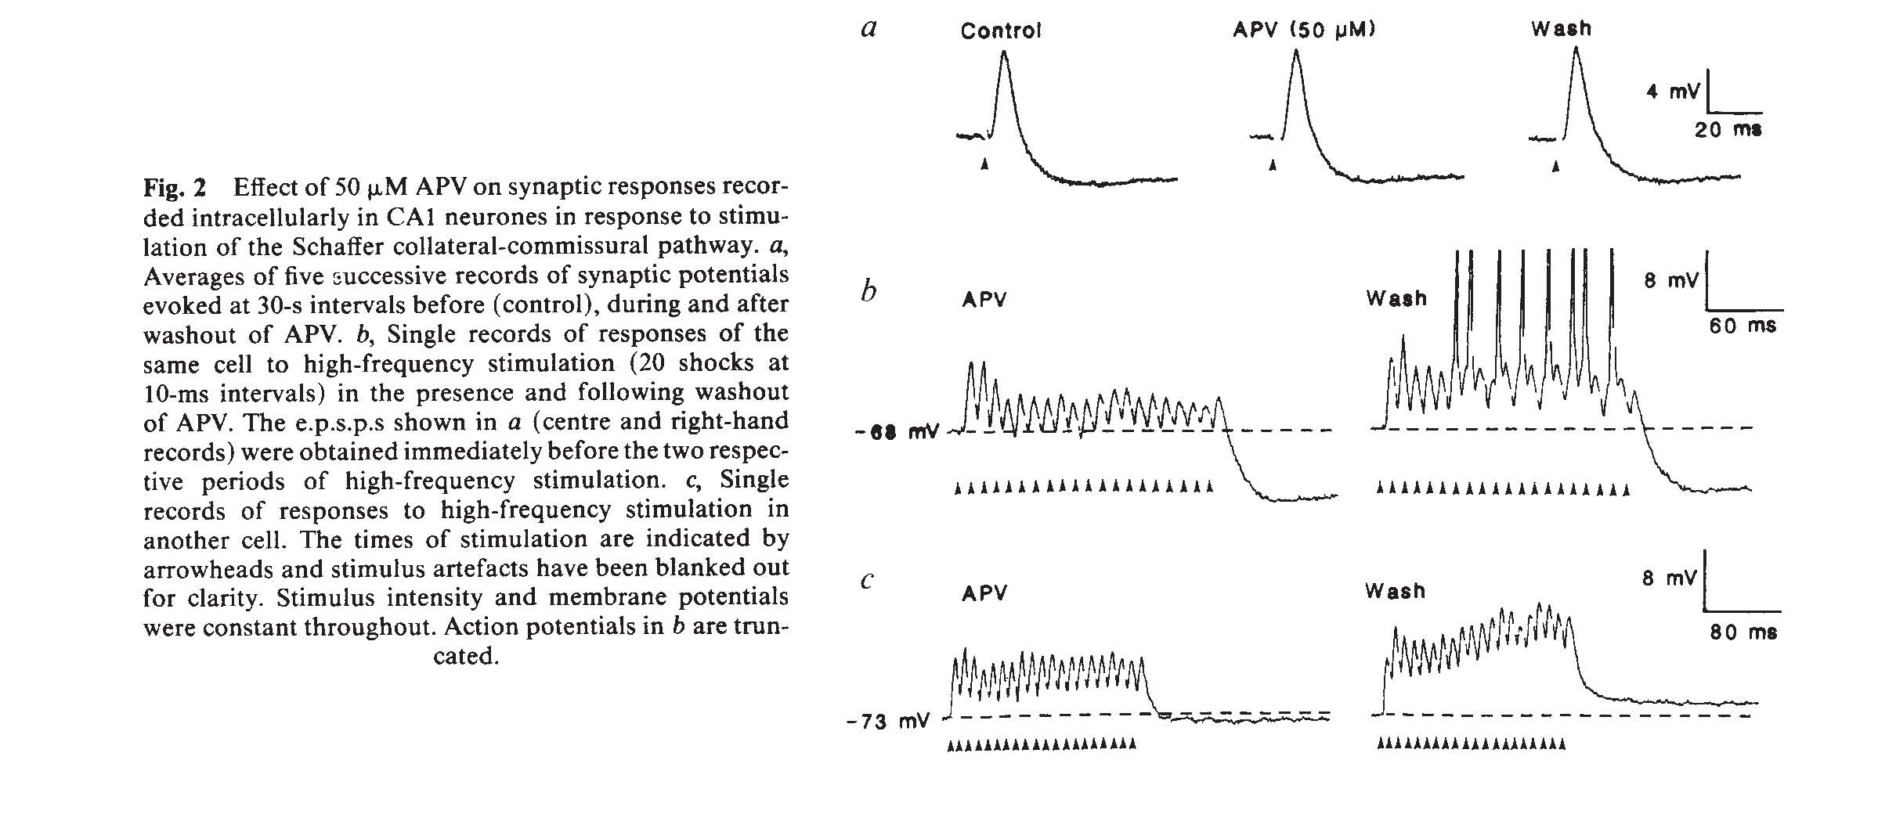
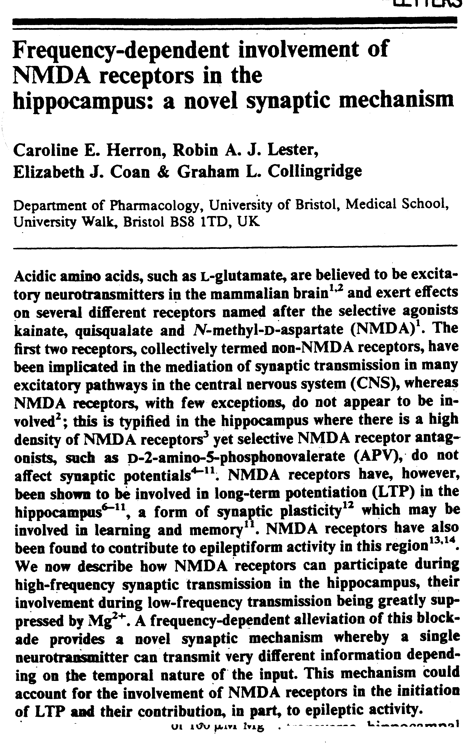
Nature 322:265-268 1986

Slide 19
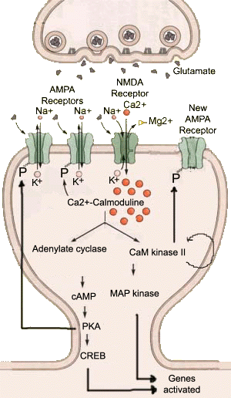
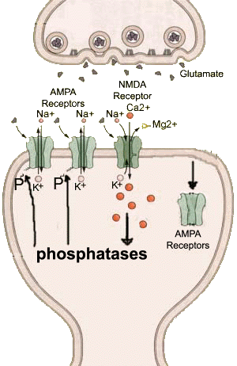
Long Term Potentiation
Long Term Depression
www.aboutmind.com

Slide 20
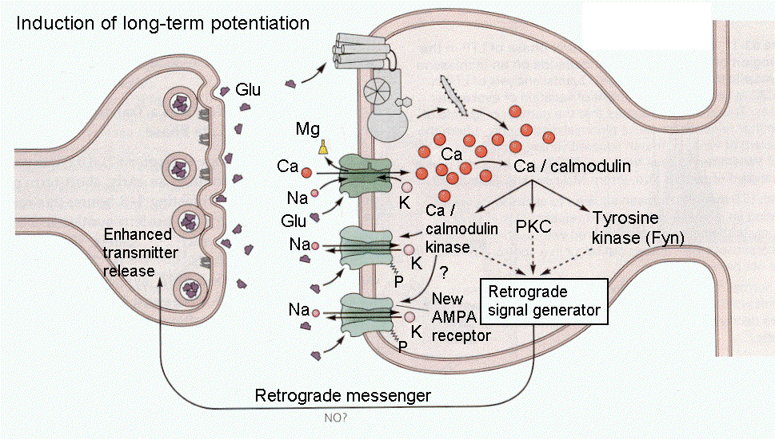
Long Term Potentiation, Cont’d

Slide 21
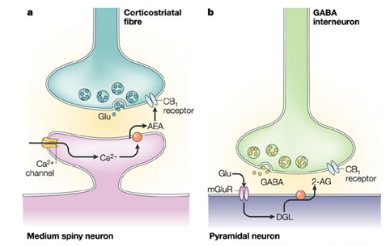
Long Term Depression, Cont’d
Endocannabinoid-
mediated
presynaptic
inhibition
D. Piomelli 2003 Nature Reviews Neuroscience 4, 873-884

Slide 22
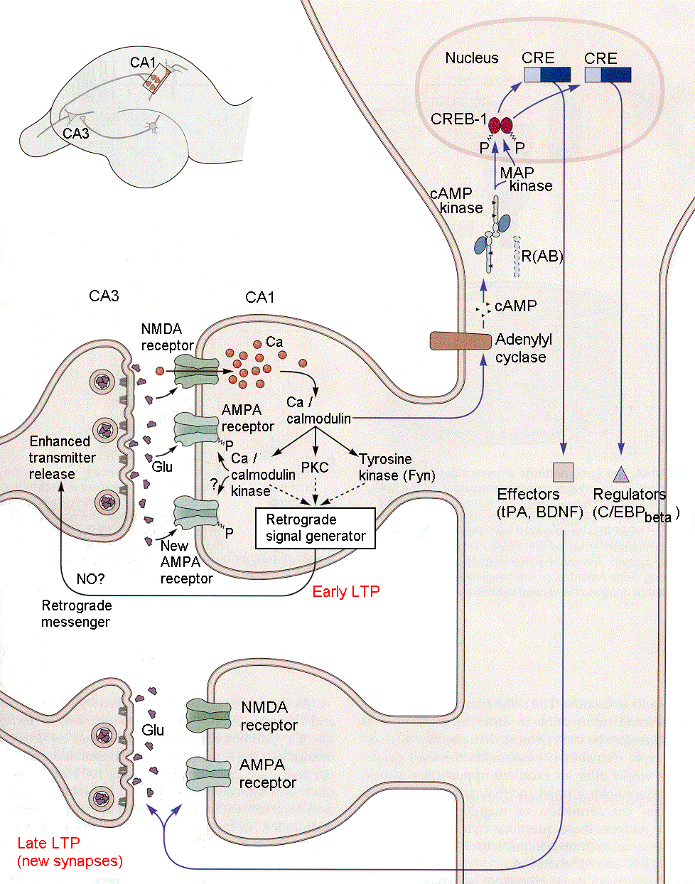
Long Term Potentiation, Cont’d

